Slide 1
DHC CaaS China (Draft)

Slide 2

DHC CaaS China Architecture and status
CaaS
CD/CI
Container Registry (Quay)
Application Container
Docker
Docker
Docker
Docker
Kubernetes
… … … …
Kubernetes
Customer
Container Management
Git (Bitbucket)
Orchestration Layer
VMware integrated OpenStack (ViO)
Virtualization Layer
ESX
NSX
VSAN
Physical Layer
Compute
Network
Storage
Notes:
SaaS Provider – as is
PaaS – IaaS Platform – nehmen wie sie ist – mit den Kunden zusammen entwickelt
Open Stack gibt uns die Möglichkeit zu wechseln

Slide 3
Planned Global CaaS Architecture(Draft)
EMEA
CHINA
CaaS Platform
CaaS Platform
Git Repository
Container Registry
Container Registry
Git Repository
Git Repository
Container Registry
Container Registry
Git Repository
NAFTA
Global Replication
APAC
CaaS Platform
CaaS Platform
Git Repository
Container Registry
Container Registry
Git Repository
Git Repository
Container Registry

Slide 4

Hosting platform for?
CaaS
DHC CaaS is perfect for:
Lightweight applications (e.g. JavaScript proxy)
Web applications
Highly distributed & replicated applications
Continuous delivery
Reduced backend connections
DHC CaaS is not perfect for:
Database servers
Monolithic applications
..
C
C
C
App

Slide 5
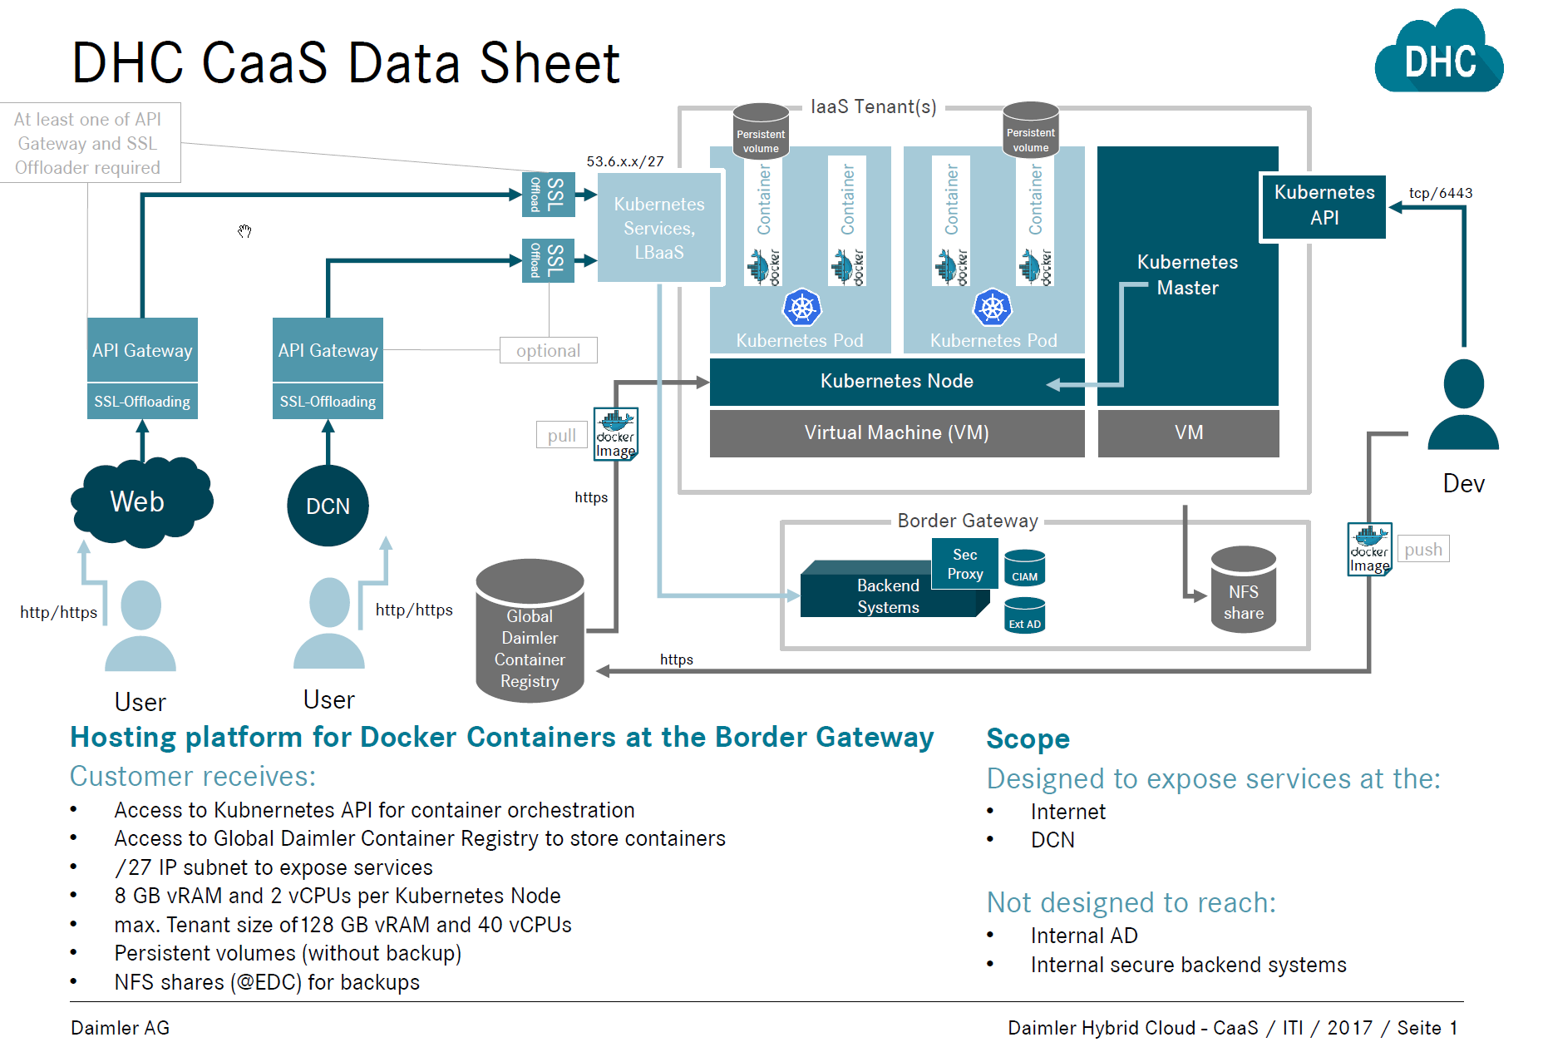
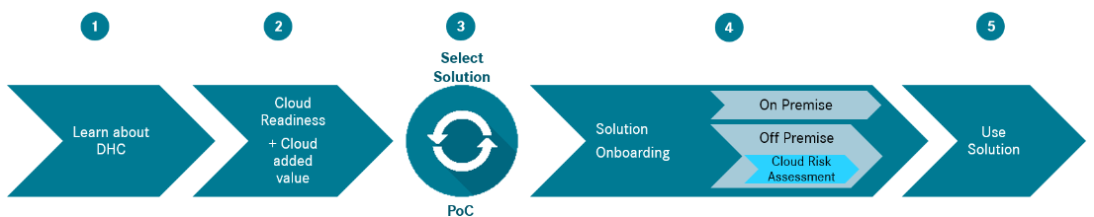
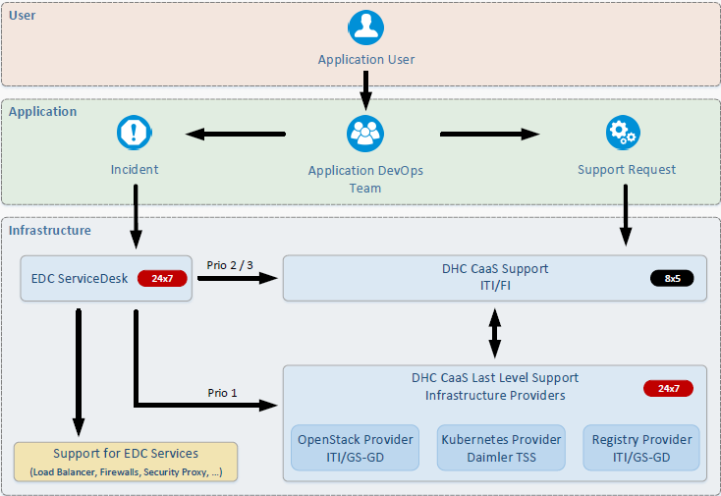
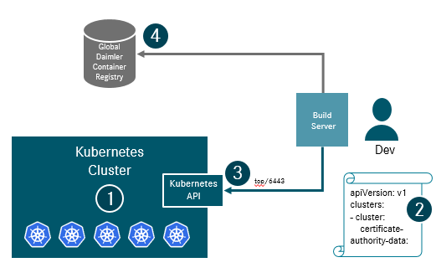
DHC CaaS Support Model
CaaS
1)Cloud Service Broker
2) Pre-Boarding Consulting
3)Instance Provisioning
4) Operation Support
Points need to clarify?
SLA of Operational Support?
DHC CaaS On-Boarding Model?
Easy of Use possibility in China?
Collaboration model and process in detail?
Overview of DHC CaaS
customer application character
Identify Pain Points
By Support of ITI/OC
The Cloud Service Brokers are first contact to DHC and help to select best fit solution in DHC
By Support of ITI/OC
*DHC in China includes – Azure, AWS, Ali, CaaS
DHC CaaS Operational support includes support requests, incident handing and etc.
By Support of ITI/FI
Deploy Tenant
Get Access to Kubernetes API
Build Server Application
By Support of ITI/OC and ITI/FI

Slide 6
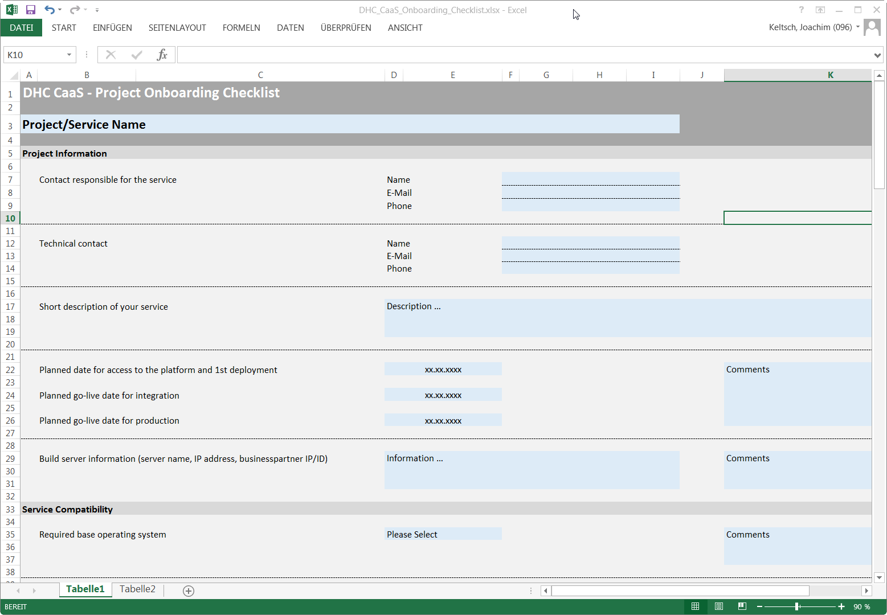
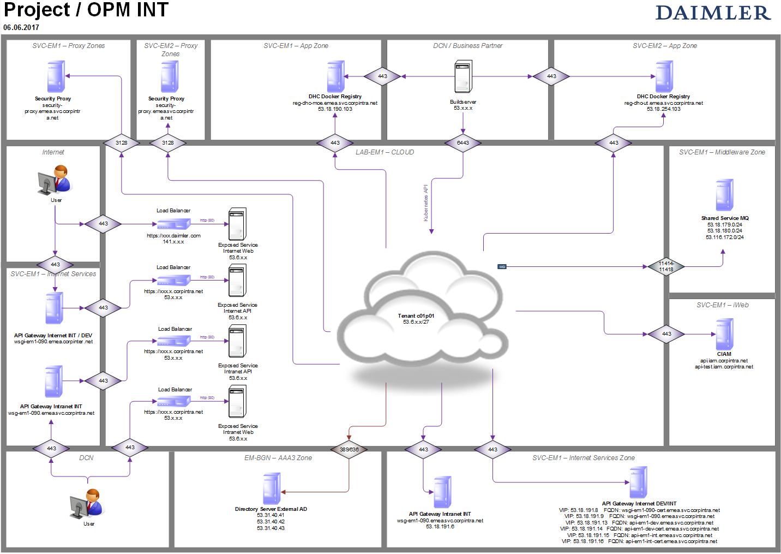
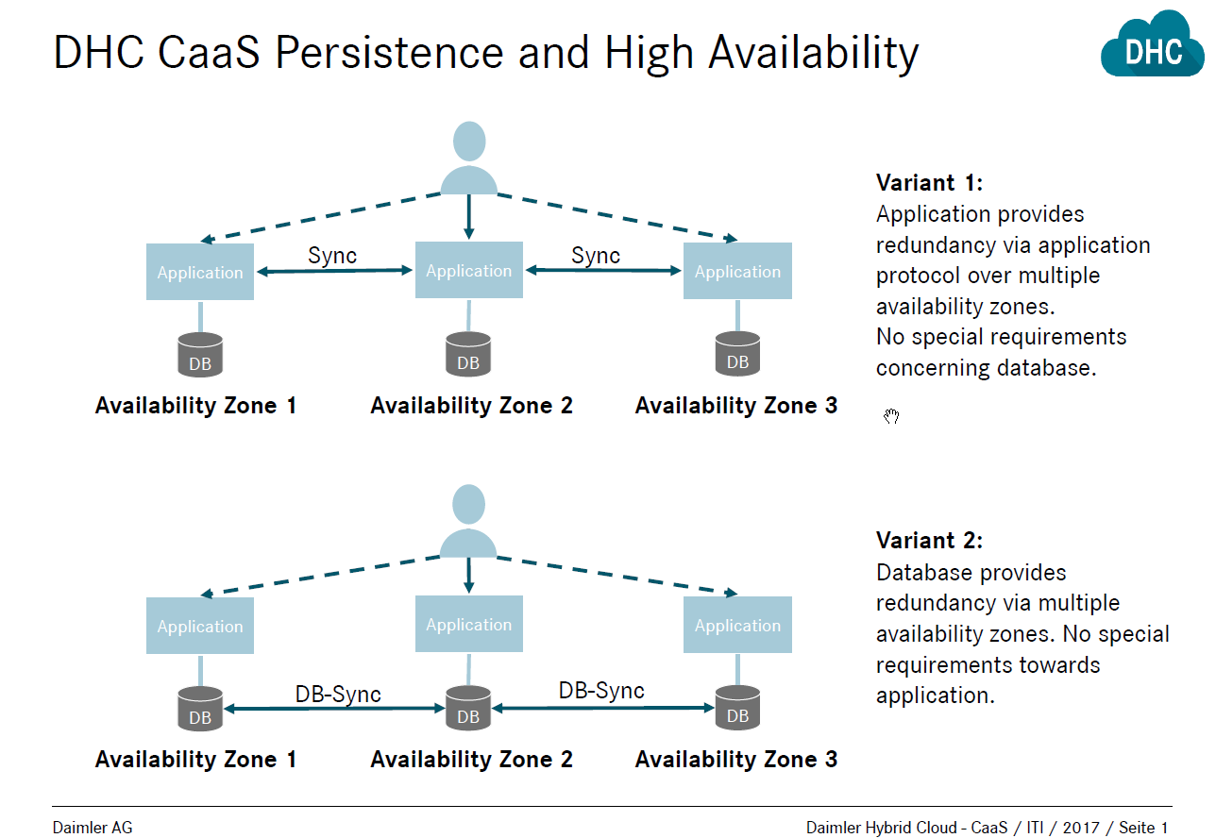
On Boarding (1/2)
CaaS
Pre Boarding Consulting:
Provide overview over DHC CaaS
Query customer application characteristics
Platform, Frameworks
Required Backend Access
Authentication/Authorization
Identify Pain Points to Customer
i.e. databases and persistence

Slide 7

On Boarding (2/2)
CaaS
On Boarding – What Will the Customer Receive?
A Tenant (1)
A cube.cfg file, including API credentials (2)
Access to the Kubernetes API (3)
Authorization to access the registry (4)
Global Daimler
Container
Registry
4
Build Server
Kubernetes Cluster
Dev
3
Kubernetes
API
apiVersion: v1
clusters:
- cluster:
certificate-authority-data:
1
2

Slide 8

DHC CaaS Deployment
CaaS
Global Daimler
Container
Registry
https
Image
2
push
Build Server
pull
Image
https
1
Kubernetes Cluster
3
Dev
4
payload
Exposed Service
Kubernetes
API
tcp/6443
End User
Deployment Process
Build server. (Like a jump server)
Push application images to the registry
Control the cluster: pull image from registry, spin containers, expose the application to the outside
End user accesses the running application
Backend
Systems

Slide 9
Three Levels of Load Balancers
CaaS
Kubernetes CaaS Tenant
Request to Node 2, Port 30000
Node Port 30000
Node Port 30000
Node Port 30000
8080
8080
POD
A
POD
B
POD
B
POD
C
POD
A
POD
C
Compute Node 1
Compute Node 2
Compute Node 3
Level 1: Internal Kubernetes Load Balancer
POD A provides Service A, listening on port 8080.
Service A of POD A is exposed as node port 30000.
Service A is then available on all node IP addresses, regardless whether or not the node hosts POD A.
Nodes without POD A then distribute requests to nodes with POD A.

Slide 10
Three Levels of Load Balancers
CaaS
Kubernetes CaaS Tenant
OpenStack LBaaS
53.6.x.x Port 80
Node Port 30000
Node Port 30000
Node Port 30000
8080
8080
POD
A
POD
B
POD
B
POD
C
POD
A
POD
C
Compute Node 1
Compute Node 2
Compute Node 3
Level 2: OpenStack Load Balancer as a Service
An OpenStack LBaaS exposes Service A on a routable IP address to the DCN.
Typically, port 80 is used on the LBaaS.
Incoming requests are distributed among all compute nodes of the CaaS Tenant.
LBaaS destination port and node port of the service must match!

Slide 11
Three Levels of Load Balancers
CaaS
Kubernetes CaaS Tenant
F5 LB
OpenStack LBaaS
xxx.app.corpintra.net VIP, Port 443
53.6.x.x Port 80
Node Port 30000
Node Port 30000
Node Port 30000
8080
8080
POD
A
POD
B
POD
B
POD
C
POD
A
POD
C
Compute Node 1
Compute Node 2
Compute Node 3
Level 3: F5 Hardware Load Balancer
An F5 hardware load balancer terminates the SSL connection
It forwards all incoming requests to the OpenStack LBaaS

Slide 12
Three Levels of Load Balancers: Processes
CaaS
Kubernetes CaaS Tenant
F5 LB
OpenStack LBaaS
xxx.app.corpintra.net VIP, Port 443
53.6.x.x Port 80
F5 Load Balancer:
Standard EDC Process
Node Port 30000
Node Port 30000
Node Port 30000
8080
8080
POD
A
POD
B
POD
B
POD
C
POD
A
POD
C
Compute Node 1
Compute Node 2
Compute Node 3
OpenStack LBaaS:
Currently CaaS Onboarding Process
Kubernetes Node Ports:
Kubernetes API

Slide 13
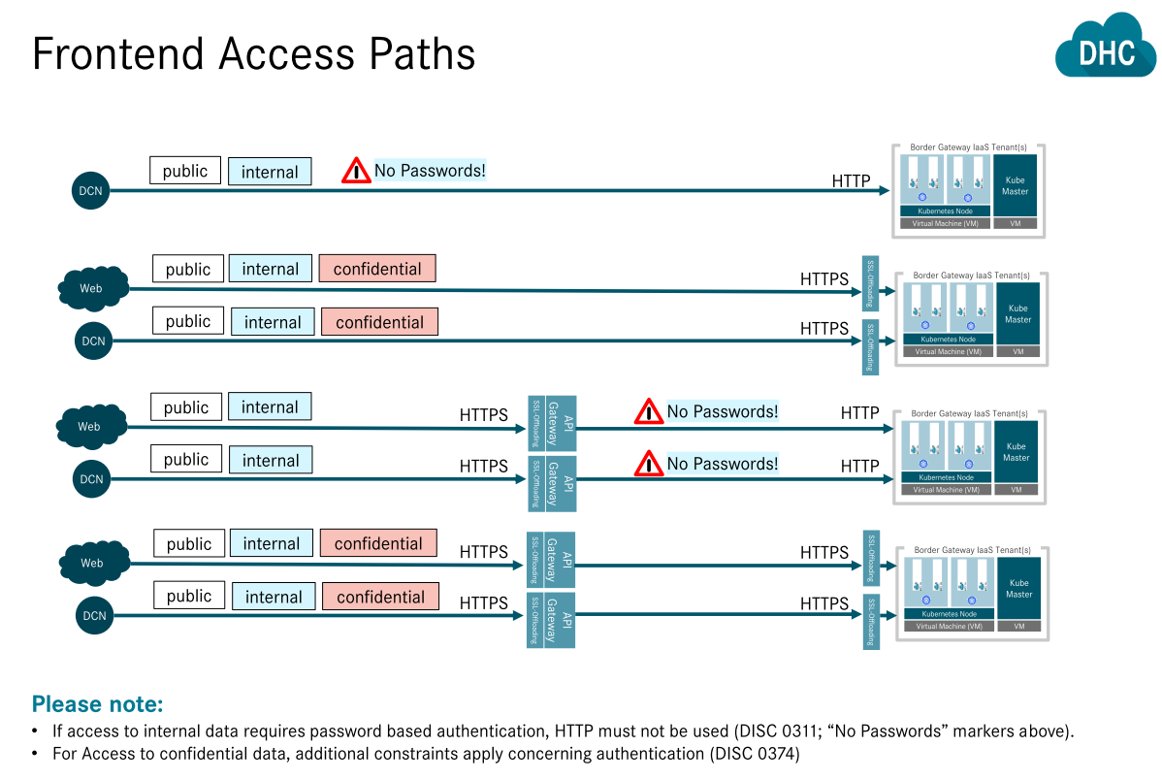
CaaS

Slide 14
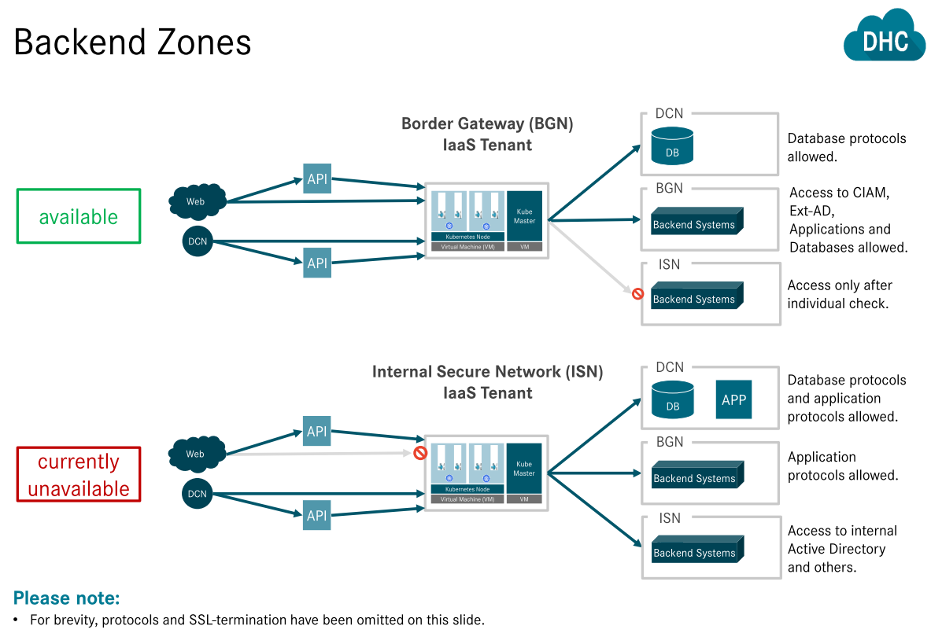
CaaS

Slide 15
DHC CaaS Procedure and Timeline
2018
2019
Jan
Feb
Mar
Apr
May
Jun
Jul
Aug
Sep
Oct
Nov
Dec
Jan
Planning
DHC CaaS Integration
DHC CaaS Production v1.0
DHC CaaS Production v2.0
Milestone
MS1
MS2
MS3
MS4
DHC CaaS Production v1.0 Go-Live
Incident Response Short-Term Solution Ready
Incident Response Long-Term Solution Ready
DHC CaaS Production v2.0 Go-Live
Today
CaaS Service v1.0 (China)
CaaS Service v2.0 (China)
Incident Management Short-Term Solution
Setup “Small” Team for devops support from ITI/OC
No Continuity Critical Application Support
Use Temp Solution for Global Roll-out Project
Incident Management Long-Term solution ready
ITI/OC Devops Lead for devops support or setup operation team
Continuity Critical Application support(The plan for DR setup of DHC CaaS in China?)
Standard Charging model
Notes:
INT changed to Production

Slide 16
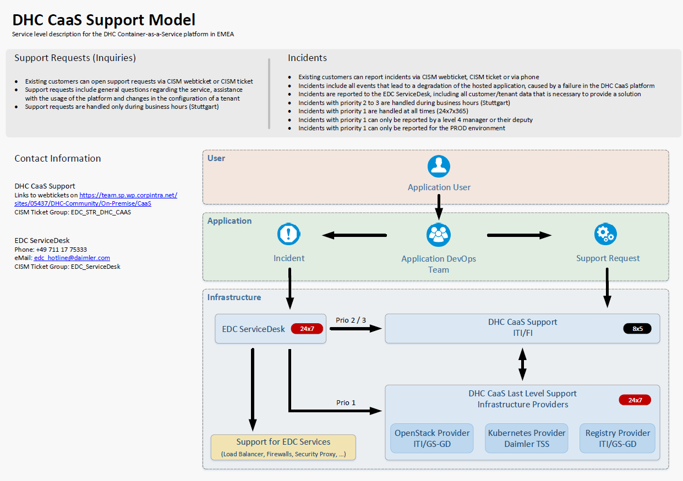
DHC support model(draft)

Slide 17
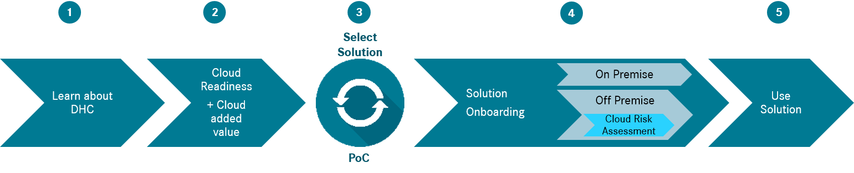
DHC CaaS On-boarding (China) - Procedure
China Roll-out & Global Roll-out
Pre-Onboarding Consultant
(ITI/OC)
Architecture Design in Detail
(ITI/OC)
Tenant Provision
(ITI/FI)
Service Operations
Global Roll-out
Global Roll-out should be directly support by ITI/FI
ITI/OC should be noticed on pre-onboarding phase
Billing from ITI/OC
China Roll-out
Follow China DHC CaaS On-Boarding procedure
Provide Overview over DHC CaaS
Operational model alignment
Accounting model alignment
Query customer application characteristics
Platform, Frameworks
Required Backend Access
Authentication/Authorization
Identify Pain Points to Customer
Databases and Persistence
Devops Integration Readiness
Feasibility deep-dive
Design the backend service and 3rd party service
OPM Creation and Security Check
Pre-Defined OPM Standard
Follow ADCC Communication Matrix
5. Deploy Datacenter Infrastructure(FW Rules, Load balancer, Build Server,…)
CISM Web ticket for tenant provisioning
Define Tenant parameters
Number of worker nodes
Number and Port of Exposed IP(LBaaS)
AD User IDs of Container Registry
Request/Incident Management
Operations Dash-board
Capacity Management
Setup China CaaS team email box for collaboration with ITI/FI

Slide 18
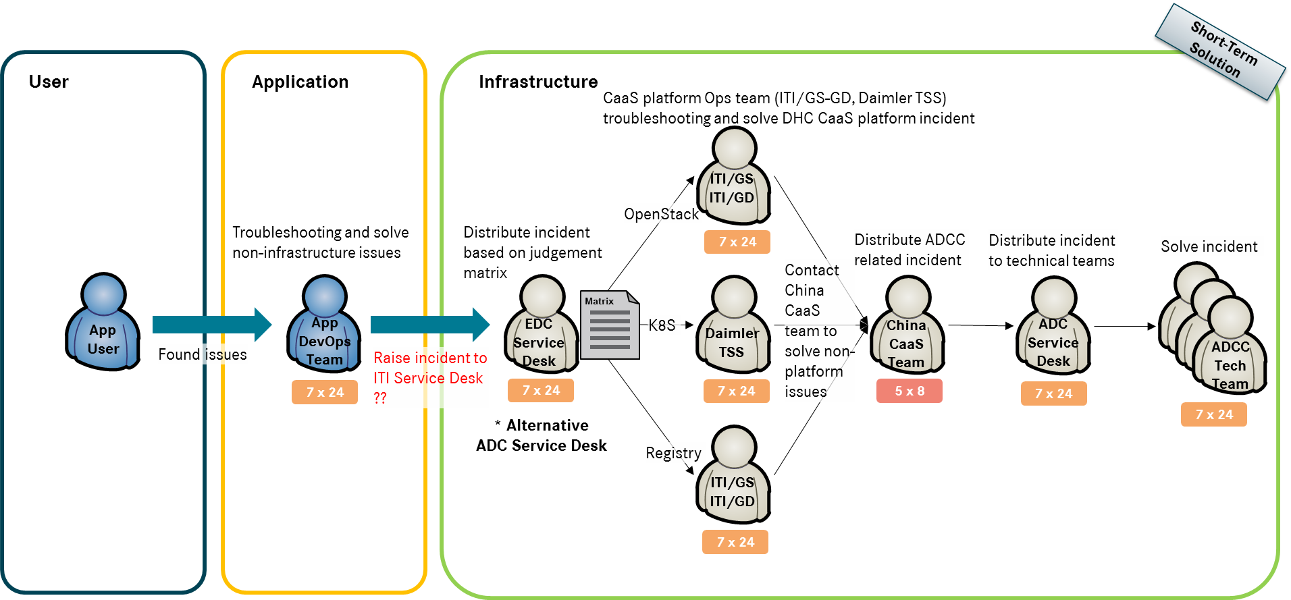
Infrastructure Operation– Incident(Draft)
For P1 incident, here is no guaranteed SLA from ITI/FI at current stage
Colleberation model between ITI/FI and ADC support is not established, then only 5*8 SLA can guaranteed if issue caused by DC facility issue
Application DevOps team try to solve incident by themselves first, if they can’t:
1st Level Support will be EDC Service Desk (7*24) (Alternative: ADC Service Desk)
2nd Level Support will be CaaS Platform Ops – Daimler TSS & ITI/GS-GD (P1: 7*24, P2/3: 5*8, *Best Effort)
In case incident is not caused by CaaS Platform, 2nd Level Support will contact CaaS China Local Team (5*8, *Temp v1.0). CaaS China Local Team will contact with ADC Service Desk (7*24) to solve incident.

Slide 19
EMEA Platform Service – Example Configuration
Example tenant resource configuration and calculated monthly fee
additional costs for mandatory registry access (next page)
Resource | Example 1 | Example 2
Compute Worker-Nodes | 3 Workers | 4 Workers
Addtional worker-node |  | 648,00€
CPU per Node | 2 Cores | 2 Cores
RAM per Node | 8 GB | 8 GB
Disk per Node | 10 GB | 10 GB
Persistent Storage | 100 GB | 100 GB
NFS Share | 100 GB | 100 GB
Tenant Fee per Month | 2.051,00 € | 2699,00 €

Slide 20
EMEA Registry Service – Mandatory for CaaS Customers(example)
Resource | Basic Access | Basic Access + 5 add. GB
Registry access
Access (151,22 €)
Included storage | 5 GB | 5 GB
Additional storage (1,70 € / GB) | -- | 5 GB
Registry Fee per Month | 151,22 € | 159,72 €

Slide 21
EMEA Git Service - Optional Service(example)
Example GIT repository (BitBucket) user configuration and calculated monthly fee
Storage is included, future price calculations will depends on overall usage
Resource | Admin Access | Admin Access + 5 repository user
Project admin access (195,55 €) | 195,55 € | 195,55 €
Repository user access (20,95 €) |  | 104,75 €
Registry Fee per Month | 195,55 € | 300,30 €

